Slide 1
Predicting the right place to build a cinema in new delhi according to feasibility

Slide 2
INTRODUCTION:-
Audience/User - Citizens of New Delhi, for entertainment purposes
Business Problem - New Delhi is the capital of the worlds most populated country, India with a population of 29.596 million. "Would you recommend a location in New Delhi to open a new cinema?“ , asked my boss. My boss, the stakeholder wants to open a new cinema as company's new business. He explains that watching movie is a part of whole afternoon or night activities. Cinemas should have many restaurants and shopping places nearby. Transportation is also an important factor. Customer can walk into cinema within 5 minutes from public transport facilities is appropriate. He wants me to concentrate on selection of cinema location according to its nearby environment. Cinema facility and rental price is not the concern. He lists out his top 10 favorite cinemas in New Delhi.

Slide 3
DATA:-
Toronto Postal Code and Neighborhood data will be used from the wiki page -https://en.wikipedia.org/wiki/List_of_cinemas_in_Delhi
Geo Coordinates will be used from the csv file provided - 'Geospatial_Coordinates.csv’.
Foursquare Data will be used to analyze different venues in the neighborhoods.

Slide 4
METHODOLOGY:-
Python Libraries Used:
Pandas and Numpy for Data Analysis
Wikipedia for extracting data from Wikipedia Page
Geopy to extract Geo Coordinates from an address
Sklearn to use K-Means Clustering
Matplotlib and Folium for Data Visualization

Slide 5
Data Collection
NewDelhi Postal Code and Neighborhood data are collected from the above mentioned wiki page with help of 'wikipedia' library.
'Geospatial_Coordinates.csv' is imported and merged with the Neighborhood data for further processing.
Foursquare Data is collected with help of API.

Slide 6
Data Wrangling and Exploratory Analysis
Neighbourhood data is wrangled by removing unassigned values to Borough and by renaming the columns
Geospatial coordinates data is then merged to the Neighbourhood data to generate the final dataframe
u

Slide 7
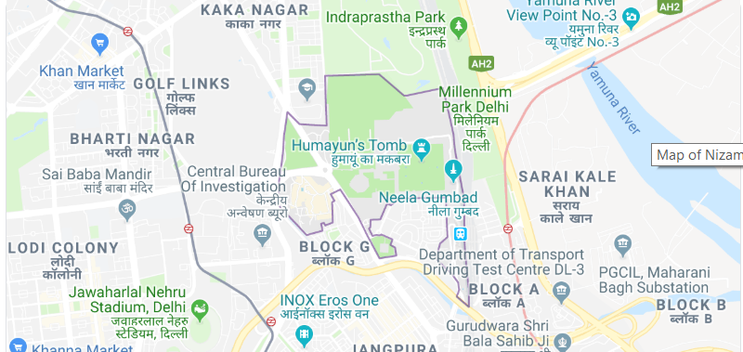
Delhi Neighborhoods look like below:-

Slide 8
3. A function is written to call the Foursquare API and get top 100 venues in the neighborhoods in Toronto.
4. Each Neighborhood is analyzed by one hot encoding to produce frequency of occurence of different venues in each neighborhood
5. The data is grouped by Neighborhood and filtered with only below venue categories Food, Shop & Service, Bus Stop, Metro Station, Nightlife Spot, Arts & Entertainment

Slide 9
K-means Clustering:-
A K-Means clustering with 3 clusters have been performed.
Cluster labels are added to the dataframe.

Slide 10
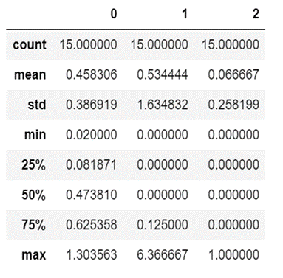
Below are the sum of occurrences of each facility in each cluster and statistics of the clusters:-

Slide 11
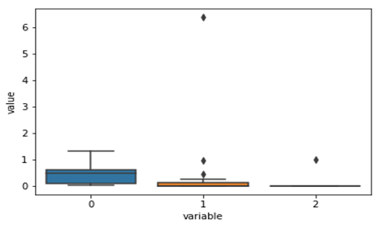
Data Visualization:-
The below box plot chart shows that wide variation and frequency of Cinemas are present in Cluster 0.

Slide 12
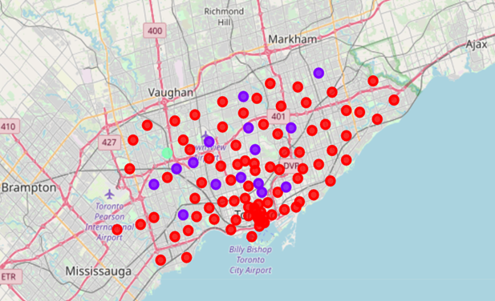
The Neighborhood clusters in the map of New Delhi has been plotted with help of matplotlib and folium.
Red dots belong to cluster 0.
Blue dots belong to cluster 1.
Green dots belong to cluster 2.

Slide 13
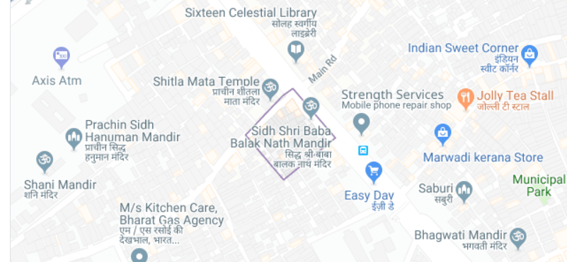
The top 5 recommended neighborhoods look like this:

Slide 14
Thank you

